Slide 1
Understanding and Working with Youth

Slide 2
Introductions
Meika Burnikel, CSW – Program Director
Family Services
Byron Wright, CSW – Executive Director
Kenosha Human Development Services, Inc.
Lisa Haen, MS – Division Director
Kenosha Human Development Services, Inc.

Slide 3
Overview of Youth Homelessness
The Runaway and Homeless Youth Act (RHYA) defines homeless youth as individuals who are “not more than 21 years of age…for whom it is not possible to live in a safe environment with a relative and who have no other safe alternative living arrangement.” This definition includes only those youth who are unaccompanied by families or caregivers.

Slide 4
Overview of Youth Homelessness
Reasons youth become homeless:
Involvement in the juvenile justice or child welfare systems (foster care)
Abuse/Neglect
Trauma
Abandonment
Severe family conflict
Childhood homelessness

Slide 5
Overview of Youth Homelessness
Family financial crisis
Residential instability – institutional or residential placements
LGBTQ
Mental health/addiction
Poverty
Pushed out/asked to leave

Slide 6
Overview of Youth Homelessness
Homeless Youth are not:
Like raising teenagers
Little adults
Just like working with any other homeless person
WHY?............

Slide 7
RHY Final Rule 2017
Youth who have become homeless or who leave and remain away from home without parental permission are disproportionately subject to serious health, behavioral, and emotional problems.
They lack sufficient resources to obtain care and may live on the street for extended periods, unable to achieve stable, safe living arrangements that at times put them in danger.

Slide 8
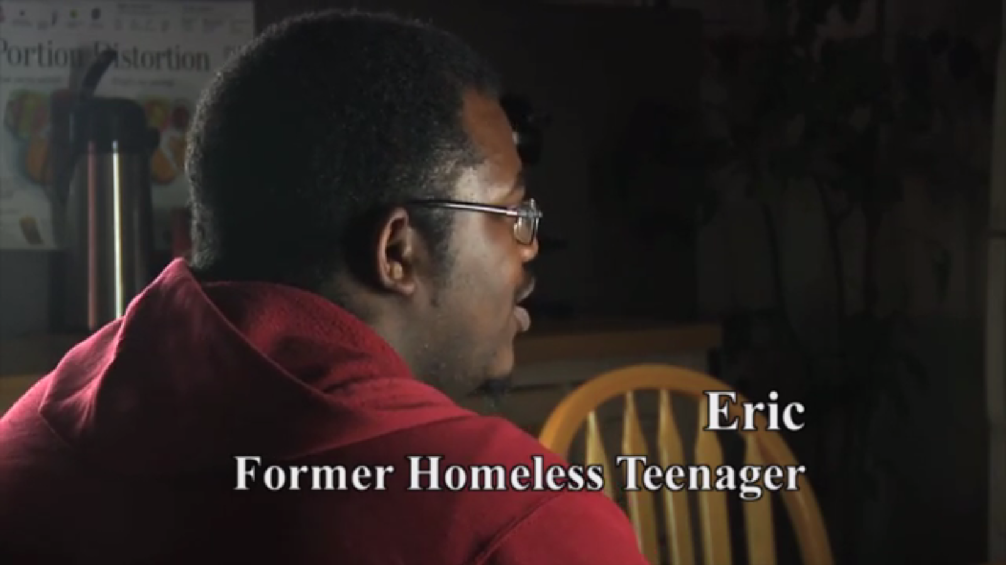
Homeless Youth in Green Bay

Slide 9
Youth Homelessness in Wisconsin
HMIS DATA 10/1/2015 - 10/1/2016

Slide 10
Youth Homelessness in Wisconsin
HMIS Aggregate counts 10/1/2015 - 9/30/2016
Count of Youth 18-21
~BOS ES, TH, SH: 768
Count of Youth 18-24
~BOS ES, TH, SH: 1459

Slide 11
HUD EXCHANGE
“Youth have unique developmental needs and our approach to youth homelessness has to do a better job taking these into account.”
“Nobody, including youth, should ever have to sleep in an unsheltered location or in a place where they are being abused or trafficked or fearful of abuse. Any youth facing those circumstances should be able to access emergency shelter, and the documentation required for them to do so should be straightforward and place as little burden on youth as possible.”
~ Anna Oliva October 14, 2014
HUD Deputy Assistant Secretary for Special Needs

Slide 12
KHDS Assumptions:
Teaching Family Model Belonging Theory:
Bowen Family Systems
Erickson’s Stages of Development
Bowen Family Systems
Belonging Theory
Teaching-Family
Model

Slide 13
KHDS Clinical Assumptions
Source | Assumption | Program Implications
Teaching Family Model University of Kansas | People lack appropriate skills Inappropriate behaviors are learned survival skills | Teach: Social, Maintenance and Academic skills
Belonging Theory Adlerian Institute DEVELOP A SENSE OF BELONGING ~Contribute/Feel Appreciated ~Involve in decision making ~Have confidence in fairness | Misbehavior, a sign of discouragement SURVIVAL STRATEGY________________ ~Attention Seeking ~Power Struggles ~Revenge | Use a positive approach ADULT FEELING_____________ ~Annoyed ~Angry ~Hurt
Bowen Family Systems | Everyone is part of a powerful family system | Understand the family system/better able to understand the behaviors of family members
Erickson’s Stages of Development | Everyone is at a different stage of development | Identify what stages have been successfully passes and what skills are still needed

Slide 14
Lost in America - Trailer

Slide 15
Resources
HUD Resources for Homeless Youth
https://www.hudexchange.info/homelessness-assistance/resources-for-homeless-youth
https://www.hudexchange.info/resource/5138/ending-youth-homelessness-a-guidebook-series
Federal Youth Services Bureau (FYSB)
https://www.acf.hhs.gov/fysb
National Network for Youth (NNY)
https://www.nn4youth.org/Federal Youth

