Slide 1
CE pre-screen & barriers assessment training
WI Balance of State CoC
November 2023

Slide 2
WI BOS Homeless Assessment:
Will replace the VI-SPDAT assessment, VI-F-SPDAT, and TAY-VI-SPDAT
Does NOT change the order of priority for each housing program
Total score will be out of 100 points and may have a decimal point
The information collected for the purpose of CE is all self report. Verification happens at project entry
The Household gets to determine their head of household. This has nothing to do with what they claim for financial reasons or for taxes.
Adults can get their own assessment and referral if they choose
90% of the points will come from the information collected on the WI BOS Pre-screen form pre-screen_final_pdf_11.2023.pdf (wiboscoc.org)
This is built directly into the system and will be calculated when entering your CE referral into HMIS or Non-HMIS
10% of the Points will come from the 6 questions on the WI BOS Barriers assessment form Barriers Assessment_Fillable_Dec 2023.pdf (wiboscoc.org)
We have created an FAQ document that we will continue to add to for support in implementation of the WI BOS Homeless Assessment and the Barriers Assessment faq_homeless_assessment_process.pdf (wiboscoc.org)

Slide 3
Measurement #1: Chronic Homeless Status
In the Defining “Chronically Homeless” Final Rule (2015) disability is defined as one or more of the following:
Physical, mental or emotional impairment, including impairment caused by alcohol or drug abuse, post-traumatic stress disorder, brain injury or a chronic physical illness that:
Is expected to be long-continuing or of indefinite duration; and
Substantially impedes the person’s ability to live independently; and
Could be improved by more suitable housing.
A homeless individual with a disability as defined in section 401(9) of the McKinney-Vento Assistance Act (42 U.S.C. 11360(9)), who:
Lives in a place not meant for human habitation, a safe haven, or in an emergency shelter, and
Has been homeless and living as described for at least 12 months* or on at least 4 separate occasions in the last 3 years, as long as the combined occasions equal at least 12 months and each break in homelessness separating the occasions included at least 7 consecutive nights of not living as described.

Slide 4
Measurement #1: Chronic Homeless Status
Comes directly from WI BOS Pre-screen form:

Slide 5
Measurement #2: Length of Time Homeless or Actively Fleeing
Actively fleeing includes domestic violence, sexual assault, human trafficking

Slide 6
Measurement #2: Length of Time Homeless or Actively Fleeing
Comes directly from WI BOS Pre-screen form:

Slide 7
Measurement #3: Living Situation/Actively Fleeing
Actively fleeing includes domestic violence, sexual assault, human trafficking

Slide 8
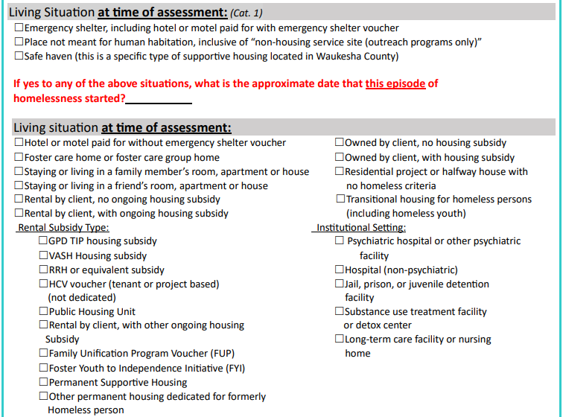
Comes directly from WI BOS Pre-screen form:

Slide 9
Measurement #4: Sub Population
Household can score in multiple factors.
TAY is defined as unaccompanied youth under the age of 25. Youth who have left foster care or will leave foster care. Can include parenting youth.

Slide 10
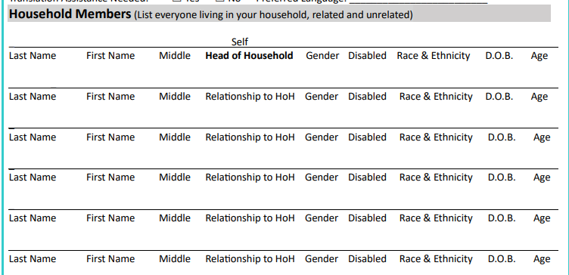
Measurement #4: Sub Population
Comes directly from WI BOS Pre-screen form:

Slide 11
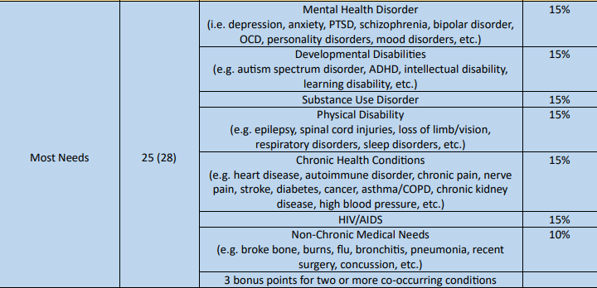
Measurement #5: Most Needs
Household can score in multiple factors.

Slide 12
Measurement #5: Most Needs
Comes directly from WI BOS Pre-screen form:

Slide 13
Measurement #6: Barriers Assessment
Please ensure you are taking a trauma informed approach when administering the barriers assessment
Inform consumers that they can decline to answer any of the questions
Inform consumers these are yes or no questions. Statements like “I have all the information I need to complete this question or this CE referral, but if you want to continue to share, I am happy to listen” empower client choice.
Barriers Assessment: Barriers Assessment_Fillable_Dec 2023.pdf (wiboscoc.org)

Slide 14
Contact Information
Ryan Graham
Homeless Systems Manager
Wisconsin Balance of State CoC
ryan.graham@wibos.org
PO Box 272, Eau Claire, WI 54702
Phone: 715-225-0164
Website: www.wiboscoc.org
Holly Sieren
Coordinated Entry Systems Specialist
Wisconsin Balance of State CoC
holly.sieren@wibos.org
PO Box 272, Eau Claire, WI 54702
Phone: 715-225-0164
Website: www.wiboscoc.org

