Slide 1
Bed Bugs??
Do You Have Them

Slide 2
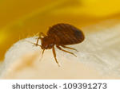
This is an adult Bed Bug… They are real and becoming an epidemic.

Slide 3
Lets learn the facts…
During the 1960’s when bed bugs were at the last epidemic level, people in the US used so many pesticides at such high levels in an attempt to eradicate the bugs that those who survived became SUPER bugs now quite immune to most pesticides.

Slide 4
Food Source:
Blood meal is the only food bed bugs rely on to survive.
This blood meal comes from humans, pets and birds.
Bed bugs can survive 6 months between feedings.

Slide 5
Reproduction:
Bed bugs only need to breed 1 time in their lives to sustain fertility and lay eggs allowing 1 Female bed bug to lay between one and five eggs each day and may lie up to 500 eggs within one lifetime. Eggs are laid singly or in clusters and are placed within tight cracks or crevices. The egg is approximately 1 mm in length and is comparable in size to two grains of salt. Within two weeks, eggs hatch and immature bed bugs begin immediately to feed.

Slide 6
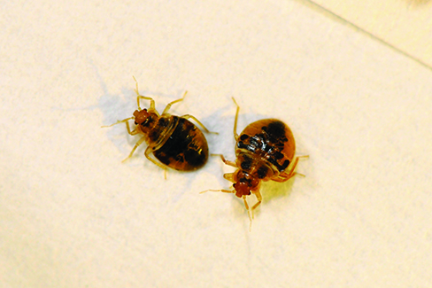
Coloring by stages:
Young nymphs are also yellow-white in color, while older nymphs and adults are reddish-brown. In order to complete a molting stage, each nymph requires a blood meal. At room temperature, nymphs molt and become adults within five weeks.

Slide 7
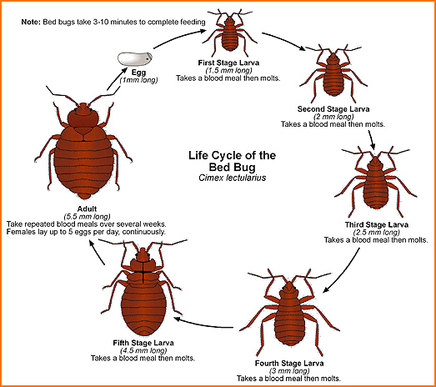
Life Cycle:

Slide 8
Where are they ???
Once fertilized, the female will lay eggs in cracks and crevices along the edges of mattresses, box springs and bed frames. Bed bugs will also inhabit other cracks and crevices throughout a room that is infested. These other areas include; behind picture frames, switch plate covers, loose wallpaper, baseboards or along the edges of carpets and any other wood furniture.

Slide 9
Signs you have bed bug bites:
Bed bugs peek period of activity is during the early morning hours, and the few hours before sunrise. It is during this time that bed bugs come out of hiding in search of a blood meal. Bed bugs DO NOT live on humans unlike lice. The only crawl onto their food source to eat then go back to their hiding spot until their next feeding. Often bites will be in a row as the bug searches for blood.

Slide 10
Continued:
Bed bugs feed almost exclusively on humans, and cause extremely itchy, irritating bites which look similar to a mosquito bite. The reason they are so itchy and irritating is that when the bed bug bites it injects enzymes and anticoagulants into the victim. These prevent the blood from clotting, and allow the bedbug to feed. The victim rarely feels the bite when it happens or during feeding, but several hours afterwards the itching starts.

Slide 11
How are they being transferred to new locations:
One of the major ways that bed bugs are spread is through human travel. Bed bugs in hotel rooms can pose a particular problem for frequent or even the occasional traveler. Imagine bed bugs entering your luggage as you sleep. One can then transport them to other hotels or back to their own home.
The clients we work with are more transient than the average person and so they are moving the bugs quicker.
College students picking up furniture and or sleeping in random places are also moving the bugs around rapidly.

Slide 12
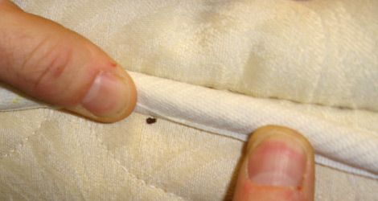
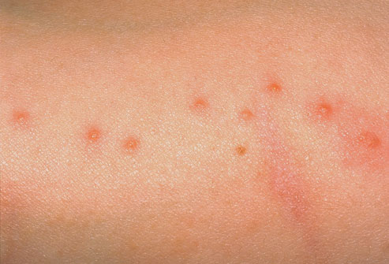
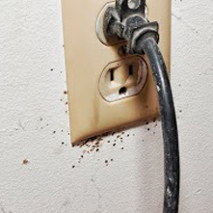
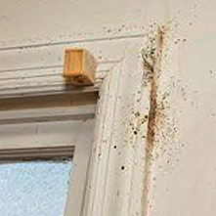
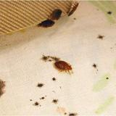
Tell tail signs bed bugs are present:

Slide 13
Treating for Bed bugs
Due to the overuse of pesticides exterminators are going back to more natural treatments to combat the problem.
Steam treatments, Diatomaceous earth (liquefied and sprayed in cracks and along edges), monitors, hotboxes and hot tents.
An average room can cost $1,000 to treat.
Hotels seldom treat.. They usually dump everything from the room and replace.
DON’T move someone from an infested room to a clean room… the bugs will follow. Stay there and treat the room.

Slide 14
Combating exposure is the key !!
1. Always keep a supply of 91% rubbing alcohol in spray bottles.
2. Upon entry to an agency keep the belongings of individuals bagged in a secluded area .
3. One bag at a time, loosely fill the clothes dryer. Dry on high for 30 – 45 minutes. (If clothing is dirty, wash first or you may set in dirt and stains.)
4. Any items, ie: duffle bags, shoes, purses, books, backpacks, suitcases, any item not capable of being tossed around in the dryer should be hotboxed for 2 cycles ( equals 1 hour)
5. Items not capable of the heat from the dryer or hotbox should be sprayed down well with the alcohol and set to dry.
6.Return items to client to be placed in a plastic bin.

Slide 15
Combating during travel and donations:
Keep your clothes in your suitcase off the floor, even take a plastic bag to put your suitcase in. Look on begbugregistry.com before traveling.
Carry a small flashlight and check the mattress edges the around the headboard (most common areas) don’t use the dressers.
Wash your things when you return.
Clean resale items well and watch garage sale items.
Even new clothing can have bugs hidden in them.
Use caution when accepting donations.
Don’t let clients have an over abundance of items in their rooms.

